Slide 1

Digital Design
Chapter 2:
Combinational Logic Design
Slides to accompany the textbook Digital Design, First Edition,
by Frank Vahid, John Wiley and Sons Publishers, 2007.
http://www.ddvahid.com
Copyright © 2007 Frank Vahid
Instructors of courses requiring Vahid's Digital Design textbook (published by John Wiley and Sons) have permission to modify and use these slides for customary course-related activities, subject to keeping this copyright notice in place and unmodified. These slides may be posted as unanimated pdf versions on publicly-accessible course websites.. PowerPoint source (or pdf with animations) may not be posted to publicly-accessible websites, but may be posted for students on internal protected sites or distributed directly to students by other electronic means. Instructors may make printouts of the slides available to students for a reasonable photocopying charge, without incurring royalties. Any other use requires explicit permission. Instructors may obtain PowerPoint source or obtain special use permissions from Wiley – see http://www.ddvahid.com for information.

Slide 2
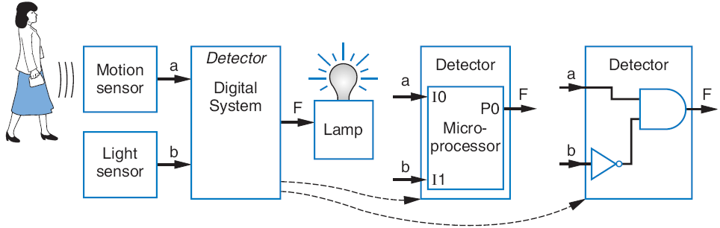
Introduction
2.1
Digital circuit
Let’s learn to design digital circuits
We’ll start with a simple form of circuit:
  Combinational circuit
    A digital circuit whose outputs depend solely on the present combination of the circuit inputs’ values
1
a
Combinational
1
0
F
b
digital circuit
1
a
Sequential
?
0
F
b
digital circuit
Note: Slides with animation are denoted with a small red "a" near the animated items

Slide 3
Switches
2.2
Electronic switches are the basis of binary digital circuits
  Electrical terminology
    Voltage: Difference in electric potential between two points
      Analogous to water pressure
    Current: Flow of charged particles
      Analogous to water flow
    Resistance: Tendency of wire to resist current flow
      Analogous to water pipe diameter
    V = I * R (Ohm’s Law)
4.5 A
–
9V
+
4.5 A
2 ohms
0
V
9
V
4.5 A

Slide 4
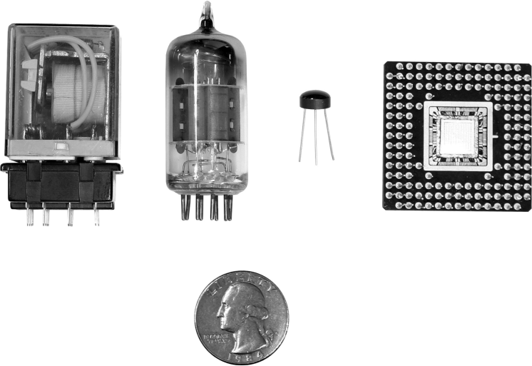
Switches
A switch has three parts
  Source input, and output
    Current wants to flow from source input to output
  Control input
    Voltage that controls whether that current can flow
The amazing shrinking switch
  1930s: Relays
  1940s: Vacuum tubes
  1950s: Discrete transistor
  1960s: Integrated circuits (ICs)
    Initially just a few transistors on IC
    Then tens, hundreds, thousands...
control
input
“off”
source
output
input
a
control
input
“on”
source
output
input
(
b
)
discrete
transistor
relay
vacuum tube
IC
quarter
(to see the relative size)

Slide 5
Boolean Algebra and its Relation to Digital Circuits
To understand the benefits of “logic gates” vs. switches, we should first understand Boolean algebra
“Traditional” algebra
  Variable represent real numbers
  Operators operate on variables, return real numbers
Boolean Algebra
  Variables represent 0 or 1 only
  Operators return 0 or 1 only
  Basic operators
    AND: a AND b returns 1 only when both a=1 and b=1
    OR: a OR b returns 1 if either (or both) a=1 or b=1
    NOT: NOT a returns the opposite of a (1 if a=0, 0 if a=1)
a
b
AND
0
0
0
0
1
0
1
0
0
a
b
OR
1
1
1
0
0
0
0
1
1
1
0
1
a
NOT
1
1
1
0
1
1
0

Slide 6
Boolean Algebra and its Relation to Digital Circuits
Developed mid-1800’s by George Boole to formalize human thought
  Ex: “I’ll go to lunch if Mary goes OR John goes, AND Sally does not go.”
    Let F represent my going to lunch (1 means I go, 0 I don’t go)
    Likewise, m for Mary going, j for John, and s for Sally
    Then F = (m OR j) AND NOT(s)
  Nice features
    Formally evaluate
      m=1, j=0, s=1 --> F = (1 OR 0) AND NOT(1) = 1 AND 0 = 0
    Formally transform
      F = (m and NOT(s)) OR (j and NOT(s))
        Looks different, but same function
        We’ll show transformation techniques soon
a
b
AND
0
0
0
0
1
0
1
0
0
1
1
1
a
b
OR
0
0
0
0
1
1
1
0
1
1
1
1
a
NOT
0
1
1
0

Slide 7
Evaluating Boolean Equations
Evaluate the Boolean equation F = (a AND b) OR (c AND d) for the given values of variables a, b, c, and d:
  Q1: a=1, b=1, c=1, d=0.
    Answer: F = (1 AND 1) OR (1 AND 0) = 1 OR 0 = 1.
  Q2: a=0, b=1, c=0, d=1.
    Answer: F = (0 AND 1) OR (0 AND 1) = 0 OR 0 = 0.
  Q3: a=1, b=1, c=1, d=1.
    Answer: F = (1 AND 1) OR (1 AND 1) = 1 OR 1 = 1.
a
a
b
AND
0
0
0
0
1
0
1
0
0
1
1
1
a
b
OR
0
0
0
0
1
1
1
0
1
1
1
1
a
NOT
0
1
1
0

Slide 8
Converting to Boolean Equations
Convert the following English statements to a Boolean equation
  Q1. a is 1 and b is 1.
    Answer: F = a AND b
  Q2. either of a or b is 1.
    Answer: F = a OR b
  Q3. both a and b are not 0.
    Answer:
      (a) Option 1: F = NOT(a) AND NOT(b)
      (b) Option 2: F = a OR b
  Q4. a is 1 and b is 0.
    Answer: F = a AND NOT(b)
a

Slide 9
Relating Boolean Algebra to Digital Design
Boolean
algebra
Boole’s intent: formalize
human thought
N
O
T
OR
AND
Symbol
x
F
x
x
(mid-1800s)
y
F
y
F
x
F
x
y
F
x
y
F
Switches
For telephone
switching and other
electronic uses
Truth table
0
1
0
0
0
0
0
0
(1930s)
1
0
0
1
1
0
1
0
1
0
1
1
0
0
1
1
1
1
1
1
Showed application
of Boolean algebra
to design of switch-
based circuits
1
0
0
Shannon (1938)
y
y
x
Transistor
circuit
x
F
x
F
F
y
Digital design
x
y
0
x
Implement Boolean operators using transistors
  Call those implementations logic gates.
  Let’s us build circuits by doing math -- powerful concept
1
1
Note: These OR/AND implementations are inefficient; we’ll show why, and show better ones later.

Slide 10


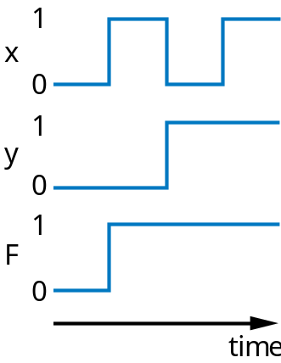
NOT/OR/AND Logic Gate Timing Diagrams
1
1
x
x
0
0
1
1
y
0
F
1
0
F
time
0
time

Slide 11
Example: Converting a Boolean Equation to a Circuit of Logic Gates
Q: Convert the following equation to logic gates: F = a AND NOT( b OR NOT(c) )
a
F
(
a
)
a
a
b
F
c
(
b
)

Slide 12


Example: Seat Belt Warning Light System
Design circuit for warning light
Sensors
  s=1: seat belt fastened
  k=1: key inserted
  p=1: person in seat
Capture Boolean equation
  person in seat, and seat belt not fastened, and key inserted
Convert equation to circuit
Notice
  Boolean algebra enables easy capture as equation and conversion to circuit
    How design with switches?
    Of course, logic gates are built from switches, but we think at level of logic gates, not switches
w = p AND NOT(s) AND k
k
BeltWarn
p
w
s

Slide 13
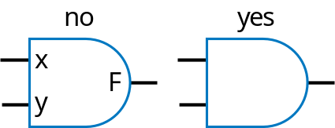
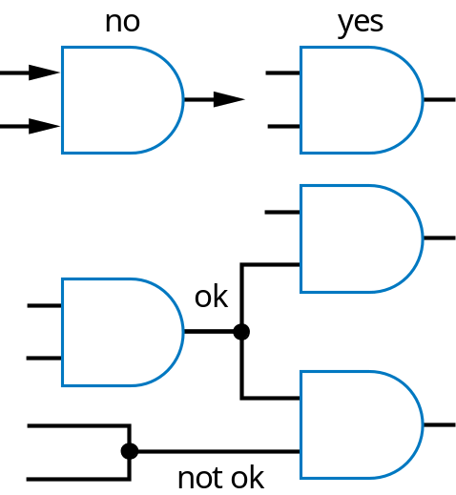
Some Circuit Drawing Conventions

Slide 14
Boolean Algebra
2.5
By defining logic gates based on Boolean algebra, we can use algebraic methods to manipulate circuits
  So let’s learn some Boolean algebraic methods
Start with notation: Writing a AND b, a OR b, and NOT(a) is cumbersome
  Use symbols: a * b, a + b, and a’ (in fact, a * b can be just ab).
    Original: w = (p AND NOT(s) AND k) OR t
    New: w = ps’k + t
      Spoken as “w equals p and s prime and k, or t”
      Or even just “w equals p s prime k, or t”
      s’ known as “complement of s”
    While symbols come from regular algebra, don’t say “times” or “plus”
Boolean algebra precedence, highest precedence first.
Symbol Name Description
( ) Parentheses Evaluate expressions nested in parentheses first
’ NOT Evaluate from left to right
* AND Evaluate from left to right
+ OR Evaluate from left to right

Slide 15
Boolean Algebra Operator Precendence
Evaluate the following Boolean equations, assuming a=1, b=1, c=0, d=1.
  Q1. F = a * b + c.
    Answer: * has precedence over +, so we evaluate the equation as F = (1 *1) + 0 = (1) + 0 = 1 + 0 = 1.
  Q2. F = ab + c.
    Answer: the problem is identical to the previous problem, using the shorthand notation for *.
  Q3. F = ab’.
    Answer: we first evaluate b’ because NOT has precedence over AND, resulting in F = 1 * (1’) = 1 * (0) = 1 * 0 = 0.
  Q4. F = (ac)’.
    Answer: we first evaluate what is inside the parentheses, then we NOT the result, yielding (1*0)’ = (0)’ = 0’ = 1.
  Q5. F = (a + b’) * c + d’.
    Answer: Inside left parentheses: (1 + (1’)) = (1 + (0)) = (1 + 0) = 1. Next, * has precedence over +, yielding (1 * 0) + 1’ = (0) + 1’. The NOT has precedence over the OR, giving (0) + (1’) = (0) + (0) = 0 + 0 = 0.
a

Slide 16
Boolean Algebra Terminology
Example equation: F(a,b,c) = a’bc + abc’ + ab + c
Variable
  Represents a value (0 or 1)
  Three variables: a, b, and c
Literal
  Appearance of a variable, in true or complemented form
  Nine literals: a’, b, c, a, b, c’, a, b, and c
Product term
  Product of literals
  Four product terms: a’bc, abc’, ab, c
Sum-of-products
  Equation written as OR of product terms only
  Above equation is in sum-of-products form. “F = (a+b)c + d” is not.

Slide 17
Boolean Algebra Properties
Commutative
  a + b = b + a
  a * b = b * a
Distributive
  a * (b + c) = a * b + a * c
  a + (b * c) = (a + b) * (a + c)
    (this one is tricky!)
Associative
  (a + b) + c = a + (b + c)
  (a * b) * c = a * (b * c)
Identity
  0 + a = a + 0 = a
  1 * a = a * 1 = a
Complement
  a + a’ = 1
  a * a’ = 0
To prove, just evaluate all possibilities
Example uses of the properties
Show abc’ equivalent to c’ba.
  Use commutative property:
    a*b*c’ = a*c’*b = c’*a*b = c’*b*a = c’ba.
Show abc + abc’ = ab.
  Use first distributive property
    abc + abc’ = ab(c+c’).
  Complement property
    Replace c+c’ by 1: ab(c+c’) = ab(1).
  Identity property
    ab(1) = ab*1 = ab.
Show x + x’z equivalent to x + z.
  Second distributive property
    Replace x+x’z by (x+x’)*(x+z).
  Complement property
    Replace (x+x’) by 1,
  Identity property
    replace 1*(x+z) by x+z.

Slide 18
Example that Applies Boolean Algebra Properties
Want automatic door opener circuit (e.g., for grocery store)
  Output: f=1 opens door
  Inputs:
    p=1: person detected
    h=1: switch forcing hold open
    c=1: key forcing closed
  Want open door when
    h=1 and c=0, or
    h=0 and p=1 and c=0
  Equation: f = hc’ + h’pc’
Found inexpensive chip that computes:
    f = c’hp + c’hp’ + c’h’p
  Can we use it?
    Is it the same as f = c’(p+h)?
Use Boolean algebra:
f = c’hp + c’hp’ + c’h’p
f = c’h(p + p’) + c’h’p (by the distributive property)
f = c’h(1) + c’h’p (by the complement property)
f = c’h + c’h’p (by the identity property)
f = hc’ + h’pc’ (by the commutative property)
Same!
h
DoorOpener
c
f
p

Slide 19
Boolean Algebra: Additional Properties
Aircraft lavatory sign example
Null elements
  a + 1 = 1
  a * 0 = 0
Idempotent Law
  a + a = a
  a * a = a
Involution Law
  (a’)’ = a
DeMorgan’s Law
  (a + b)’ = a’b’
  (ab)’ = a’ + b’
  Very useful!
To prove, just evaluate all possibilities
Behavior
  Three lavatories, each with sensor (a, b, c), equals 1 if door locked
  Light “Available” sign (S) if any lavatory available
Equation and circuit
  S = a’ + b’ + c’
Transform
  (abc)’ = a’+b’+c’ (by DeMorgan’s Law)
  S = (abc)’
New equation and circuit
  Alternative: Instead of lighting “Available,” light “Occupied”
  Opposite of “Available” function S = a’ + b’ + c’
  So S’ = (a’ + b’ + c’)’
    S’ = (a’)’ * (b’)’ * (c’)’ (by DeMorgan’s Law)
    S’ = a * b * c (by Involution Law)
  Makes intuitive sense
    Occupied if all doors are locked
Circuit
a
Circuit
S
a
S
b
b
c
c

Slide 20
Representations of Boolean Functions
2.6
English 1: F outputs 1 when a is 0 and b is 0, or when a is 0 and b is 1.
English 2: F outputs 1 when a is 0, regardless of b’s value
(
a
)
a
a
b
F
b
0
0
1
Equation 1: F(a,b) = a’b’ + a’b
F
0
1
1
Equation 2: F(a,b) = a’
1
0
0
(
b
)
(
c
)
1
1
0
Circuit 1
Truth table
a
F
(
d
)
Circuit 2
T
he function F
A function can be represented in different ways
  Above shows seven representations of the same functions F(a,b), using four different methods: English, Equation, Circuit, and Truth Table

Slide 21
Truth Table Representation of Boolean Functions
Define value of F for each possible combination of input values
  2-input function: 4 rows
  3-input function: 8 rows
  4-input function: 16 rows
Q: Use truth table to define function F(a,b,c) that is 1 when abc is 5 or greater in binary
a
b
F
a
b
c
F
a
b
c
d
F
0
0
0
0
0
0
0
0
0
0
1
0
0
1
0
0
0
1
1
0
0
1
0
0
0
1
0
1
1
0
1
1
0
0
1
1
(
a
)
1
0
0
0
1
0
0
1
0
1
0
1
0
1
1
1
0
0
1
1
0
1
1
1
0
1
1
1
(
b
)
1
0
0
0
1
0
0
1
a
b
c
F
1
0
1
0
0
0
0
0
1
0
1
1
0
0
1
0
1
1
0
0
a
0
1
0
0
1
1
0
1
0
1
1
0
1
1
1
0
1
0
0
0
1
1
1
1
1
0
1
1
(
c
)
1
1
0
1
1
1
1
1

Slide 22
Converting among Representations
Can convert from any representation to any other
Common conversions
  Equation to circuit (we did this earlier)
  Truth table to equation (which we can convert to circuit)
    Easy -- just OR each input term that should output 1
  Equation to truth table
    Easy -- just evaluate equation for each input combination (row)
    Creating intermediate columns helps
Inputs
Outputs
Term
a
b
F
F = sum of
0
0
1
a’b’
0
1
1
a’b
1
0
0
1
1
0
F = a’b’ + a’b
Q: Convert to equation
a
b
c
F
0
0
0
0
0
0
1
0
0
1
0
0
0
1
1
0
Q: Convert to truth table: F = a’b’ + a’b
1
0
0
0
1
0
1
1
ab’c
Inputs
Output
1
abc’
a
b
a
'
b
'
a
' b
F
1
1
0
1
1
1
1
abc
a
0
0
1
0
1
a
0
1
0
1
1
F = ab’c + abc’ + abc
1
0
0
0
0
1
1
0
0
0

Slide 23
Standard Representation: Truth Table
How can we determine if two functions are the same?
  Recall automatic door example
    Same as f = hc’ + h’pc’?
    Used algebraic methods
    But if we failed, does that prove not equal? No.
Solution: Convert to truth tables
  Only ONE truth table representation of a given function
    Standard representation -- for given function, only one version in standard form exists
f = c’hp + c’hp’ + c’h’
f = c’h(p + p’) + c’h’p
f = c’h(1) + c’h’p
f = c’h + c’h’p
(what if we stopped here?)
f = hc’ + h’pc’
Q: Determine if F=ab+a’ is same
function as F=a’b’+a’b+ab, by converting
each to truth table first
F = ab + a
'
F = a’b’ +
a’b + ab
a
b
F
a
b
F
0
0
1
0
0
1
a
0
1
Same
1
0
1
1
1
0
0
1
0
0
1
1
1
1
1
1

Slide 24
Canonical Form -- Sum of Minterms
Truth tables too big for numerous inputs
Use standard form of equation instead
  Known as canonical form
  Regular algebra: group terms of polynomial by power
    ax² + bx + c (3x² + 4x + 2x² + 3 + 1 --> 5x² + 4x + 4)
  Boolean algebra: create sum of minterms
    Minterm: product term with every function literal appearing exactly once, in true or complemented form
    Just multiply-out equation until sum of product terms
    Then expand each term until all terms are minterms
Q: Determine if F(a,b)=ab+a’ is same function as F(a,b)=a’b’+a’b+ab, by converting first equation to canonical form (second already in canonical form)
F = ab+a’ (already sum of products)
F = ab + a’(b+b’) (expanding term)
F = ab + a’b + a’b’ (SAME -- same three terms as other equation)
a

Slide 25
Multiple-Output Circuits
Many circuits have more than one output
Can give each a separate circuit, or can share gates
Ex: F = ab + c’, G = ab + bc
a
a
b
b
F
F
c
c
G
G
(
a
)
(
b
)
Option 1: Separate circuits
Option 2: Shared gates

Slide 26
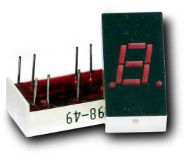
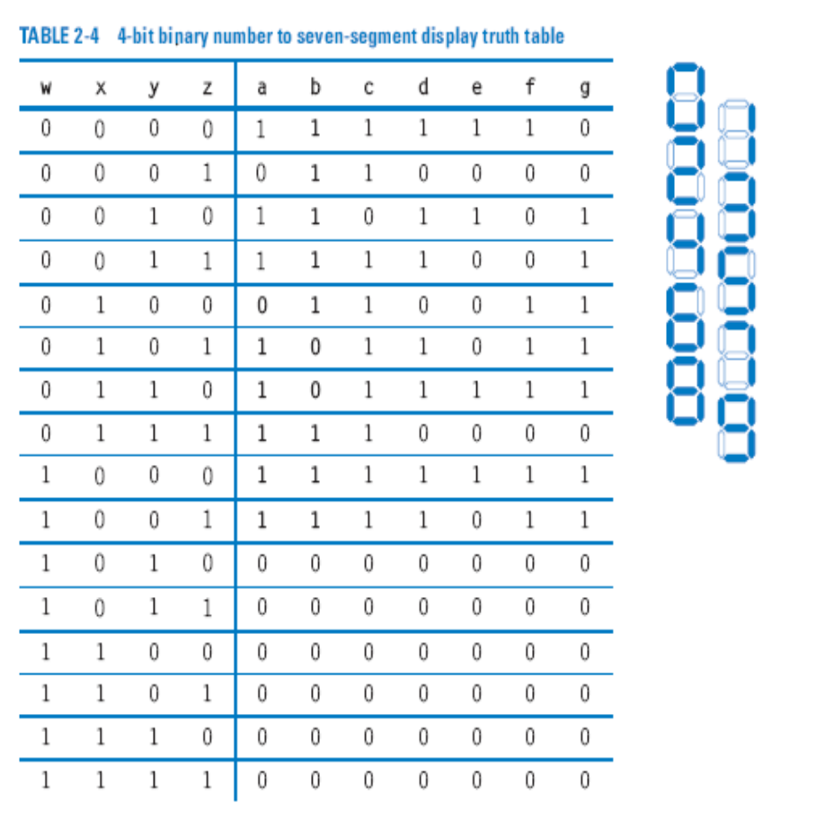
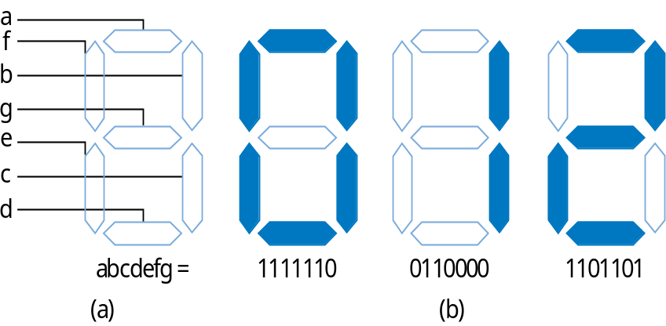
Multiple-Output Example:
BCD to 7-Segment Converter
a = w’x’y’z’ + w’x’yz’ + w’x’yz + w’xy’z + w’xyz’ + w’xyz + wx’y’z’ + wx’y’z
b = w’x’y’z’ + w’x’y’z + w’x’yz’ + w’x’yz + w’xy’z’ + w’xyz + wx’y’z’ + wx’y’z

Slide 27
Combinational Logic Design Process
2.7
Step
Description
Step 1
Capture the function
Create a truth table or equations, whichever is most natural for the given problem, to describe the desired behavior of the combinational logic.
Step 2
Convert to equations
This step is only necessary if you captured the function using a truth table instead of equations. Create an equation for each output by ORing all the minterms for that output. Simplify the equations if desired.
Step 3
Implement as a gate-based circuit
For each output, create a circuit corresponding to the output’s equation. (Sharing gates among multiple outputs is OK optionally.)

Slide 28
Example: Three 1s Detector
Problem: Detect three consecutive 1s in 8-bit input: abcdefgh
    00011101 → 1 10101011 → 0 11110000 → 1
  Step 1: Capture the function
    Truth table or equation?
      Truth table too big: 2^8=256 rows
      Equation: create terms for each possible case of three consecutive 1s
    y = abc + bcd + cde + def + efg + fgh
  Step 2: Convert to equation -- already done
  Step 3: Implement as a gate-based circuit
a
a
a
abc
b
c
bcd
d
cde
e
y
def
f
efg
g
fgh
h

Slide 29
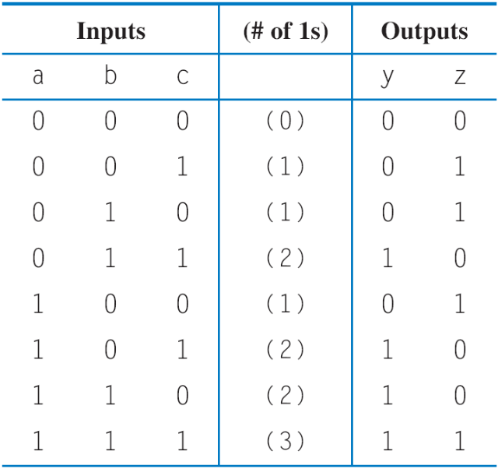
Example: Number of 1s Count
Problem: Output in binary on two outputs yz the number of 1s on three inputs
    010 → 01 101 → 10 000 → 00
  Step 1: Capture the function
    Truth table or equation?
      Truth table is straightforward
  Step 2: Convert to equation
    y = a’bc + ab’c + abc’ + abc
    z = a’b’c + a’bc’ + ab’c’ + abc
  Step 3: Implement as a gate-based circuit
a
b
a
c
b
c
a
b
a
y
c
z
b
c
a
b
a
c
b
a
b
c

Slide 30
More Gates
2.8
1
NAND
1
NOR
NAND
NOR
XOR
XNOR
x
x
x
F
F
x
y
y
y
F
y
x
y
F
x
y
F
x
y
F
x
y
F
x
F
0
0
1
0
0
1
0
0
0
0
0
1
0
1
1
0
1
0
0
1
1
0
1
0
x
y
1
0
1
1
0
0
1
0
1
1
0
0
y
1
1
0
1
1
0
1
1
0
1
1
1
0
0
NAND: Opposite of AND (“NOT AND”)
NOR: Opposite of OR (“NOT OR”)
XOR: Exactly 1 input is 1, for 2-input XOR. (For more inputs -- odd number of 1s)
XNOR: Opposite of XOR (“NOT XOR”)
NAND same as AND with power & ground switched
  Why? nMOS conducts 0s well, but not 1s (reasons beyond our scope) -- so NAND more efficient
Likewise, NOR same as OR with power/ground switched
AND in CMOS: NAND with NOT
OR in CMOS: NOR with NOT
So NAND/NOR more common

Slide 31
More Gates: Example Uses
Aircraft lavatory sign example
  S = (abc)’
Detecting all 0s
  Use NOR
Detecting equality
  Use XNOR
Detecting odd # of 1s
  Use XOR
  Useful for generating “parity” bit common for detecting errors
Circuit
a
b
S
c
0
0
1
a0
0
b0
a1
A=B
b1
a2
b2

Slide 32
Completeness of NAND
Any Boolean function can be implemented using just NAND gates. Why?
  Need AND, OR, and NOT
  NOT: 1-input NAND (or 2-input NAND with inputs tied together)
  AND: NAND followed by NOT
  OR: NAND preceded by NOTs
Likewise for NOR

Slide 33
Number of Possible Boolean Functions
How many possible functions of 2 variables?
  2² rows in truth table, 2 choices for each
  2⁽²²⁾ = 2⁴ = 16 possible functions
N variables
  2^{N} rows
  2^{(2N)} possible functions
a
b
F
0
0
0 or 1 2 choices
0
1
0 or 1 2 choices
1
0
0 or 1 2 choices
1
1
0 or 1 2 choices
2⁴ = 16
possible functions
a
b
f0
f1
f2
f3
f4
f5
f6
f7
f8
f9
f10
f11
f12
f13
f14
f15
0
0
0
0
0
0
0
0
0
0
1
1
1
1
1
1
1
1
0
1
0
0
0
0
1
1
1
1
0
0
0
0
1
1
1
1
1
0
0
0
1
1
0
0
1
1
0
0
1
1
0
0
1
1
1
1
0
1
0
1
0
1
0
1
0
1
0
1
0
1
0
1
0
a
b
b’
a’
1
0
a
b
a OR b
'
'
1
a AND b
a XOR b
a NOR b
b
a
a NAND b
OR b
a XNOR b
X
a OR b
a AND b
a
a NOR b
a XNOR b
a NAND b

Slide 34
Decoders and Muxes
2.9
Decoder: Popular combinational logic building block, in addition to logic gates
  Converts input binary number to one high output
2-input decoder: four possible input binary numbers
  So has four outputs, one for each possible input binary number
Internal design
  AND gate for each output to detect input combination
Decoder with enable e
  Outputs all 0 if e=0
  Regular behavior if e=1
n-input decoder: 2^{n} outputs
d0
1
d0
0
d0
0
d0
0
0
i0
d1
0
1
i0
d1
1
0
i0
d1
0
1
i0
d1
0
0
i1
d2
0
0
i1
d2
0
1
i1
d2
1
1
i1
d2
0
d3
0
d3
0
d3
0
d3
1
i1’i0’
d0
d0
0
1
i0
d1
0
i1’i0
d1
1
i1
d2
0
e
d3
1
i1i0’
d2
1
i1i0
d3
d0
0
1
i0
d1
0
1
i1
d2
0
e
d3
0
i1
i0
0

Slide 35
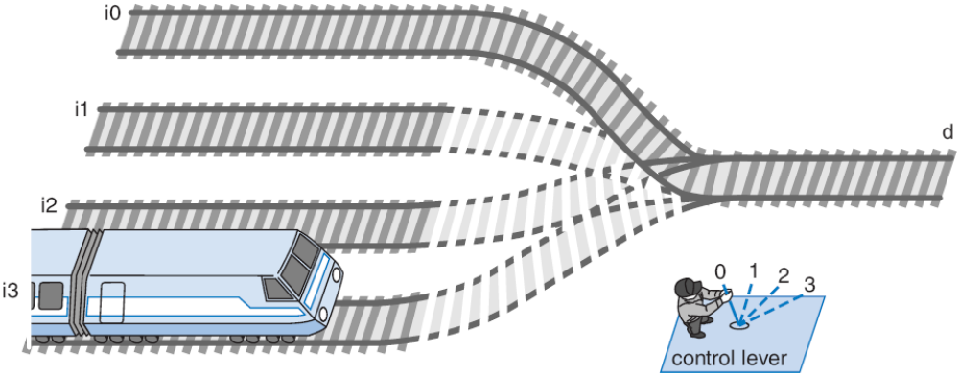
Multiplexor (Mux)
Mux: Another popular combinational building block
  Routes one of its N data inputs to its one output, based on binary value of select inputs
    4 input mux → needs 2 select inputs to indicate which input to route through
    8 input mux → 3 select inputs
    N inputs → log₂(N) selects
  Like a railyard switch

Slide 36
Mux Internal Design
i0
i0 (1*i0=i0)
2
×
1
2
×
1
2
×
1
1
d
i0
(0+i0=i0)
i0
i0
i0
i1
i1
d
i1
d
i1
d
0
0
s0
s0
s0
a
0
1
2x1 mux
0
s0
i0
4
⋅
1
i0
i1
i1
d
i2
d
i2
i3
s1
s0
i3
4x1 mux
s1
s0

Slide 37
Mux Example
City mayor can set four switches up or down, representing his/her vote on each of four proposals, numbered 0, 1, 2, 3
City manager can display any such vote on large green/red LED (light) by setting two switches to represent binary 0, 1, 2, or 3
Use 4x1 mux
Mayor’s switches
1
4x1
on/off
i0
2
i1
i2
d
r
3
i3
Green/
Red
LED
P
s1
s0
4
manager's
switches

Slide 38
Muxes Commonly Together -- N-bit Mux
a3
i0
2
⋅
1
Simplifying
notation:
b3
i1
d
s0
4-bit
4
a2
i0
2
⋅
1
4
2x1
C
i1
d
A
I
0
4
b2
s0
4
D
C
is short
B
I
1
f
or
a1
i0
2
⋅
1
s0
b1
i1
d
c3
s0
2
⋅
1
s0
c2
a0
i0
d
b0
i1
c1
s0
s0
c0
Ex: Two 4-bit inputs, A (a3 a2 a1 a0), and B (b3 b2 b1 b0)
  4-bit 2x1 mux (just four 2x1 muxes sharing a select line) can select between A or B

Slide 39
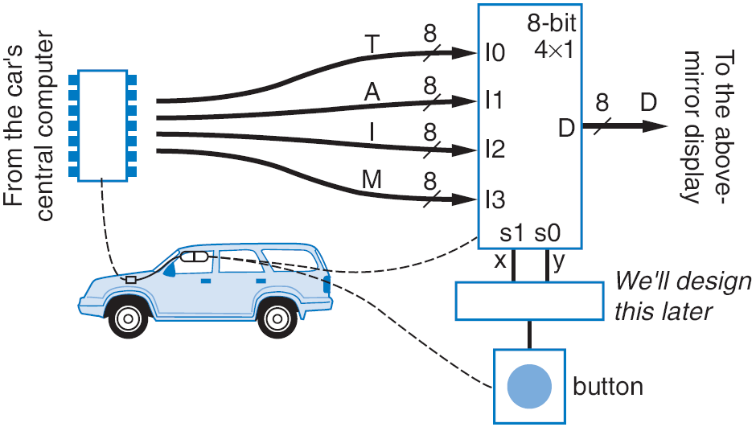
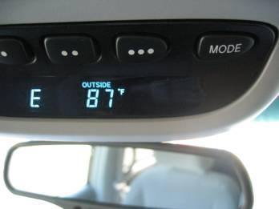
N-bit Mux Example
Four possible display items
  Temperature (T), Average miles-per-gallon (A), Instantaneous mpg (I), and Miles remaining (M) -- each is 8-bits wide
  Choose which to display using two inputs x and y
  Use 8-bit 4x1 mux

Slide 40
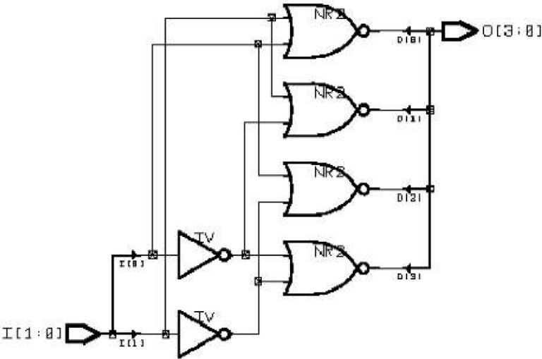
Additional Considerations
Schematic Capture and Simulation
2.10
Inputs
Inputs
i0
i0
i1
Simulate
i1
Simulate
Outputs
Outputs
d3
d3
d2
d2
d1
d1
d0
d0
Schematic capture
  Computer tool for user to capture logic circuit graphically
Simulator
  Computer tool to show what circuit outputs would be for given inputs
    Outputs commonly displayed as waveform

Slide 41
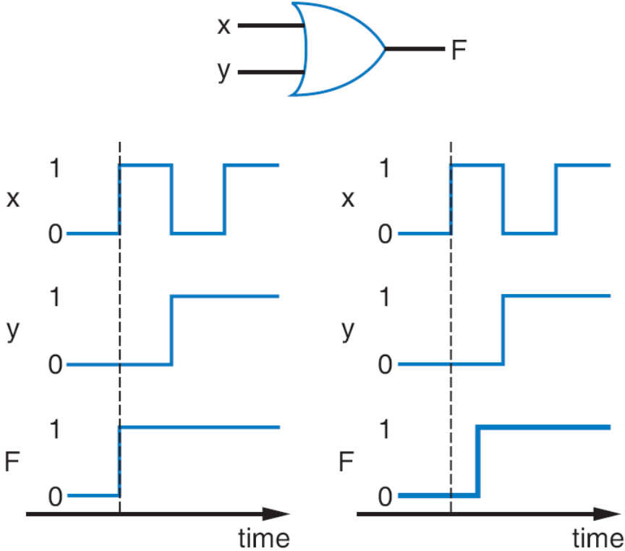
Additional Considerations
Non-Ideal Gate Behavior -- Delay
Real gates have some delay
  Outputs don’t change immediately after inputs change

Slide 42
Chapter Summary
Combinational circuits
  Circuit whose outputs are function of present inputs
    No “state”
Switches: Basic component in digital circuits
Boolean logic gates: AND, OR, NOT -- Better building block than switches
  Enables use of Boolean algebra to design circuits
Boolean algebra: uses true/false variables/operators
Representations of Boolean functions: Can translate among
Combinational design process: Translate from equation (or table) to circuit through well-defined steps
More gates: NAND, NOR, XOR, XNOR also useful
Muxes and decoders: Additional useful combinational building blocks

